Slide 1
Algorithms
Lecture 2.1
Dr. Md Moniruzzaman

Slide 2
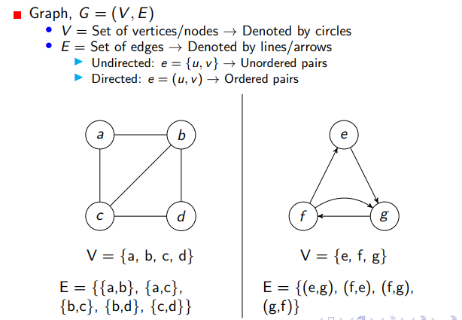
Graph

Slide 3
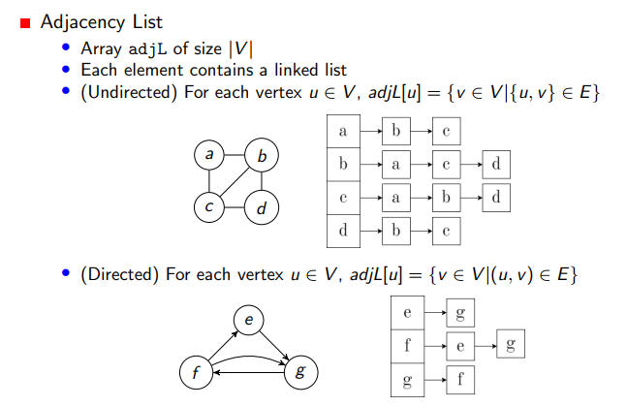
Adjacency List

Slide 4
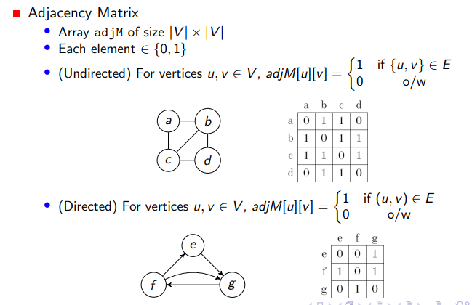
Adjacency Matrix

Slide 5
BFS
Declare a queue and insert the starting vertex.
Initialize a visited array and mark the starting vertex as visited.
Follow the below process till the queue becomes empty:
Remove the first vertex of the queue.
Insert all the unvisited neighbors of the vertex into the queue and mark that vertex as visited.

Slide 6
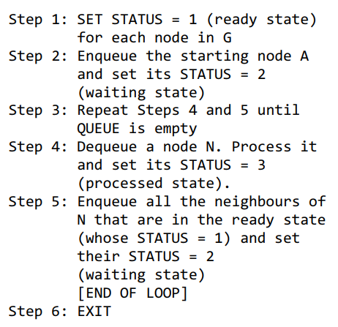
BFS

Slide 7
Implementation
Using vector to store the graph as adjacency list:
vector<int> lst[MAX]; //this is an array of vectors
To insert an element: lst[index].push_back(value);
To get the size of the vector: int sz = lst[index].size();
To maintain a Queue:
queue<int> Q;
To insert an element: Q.push(node);
To retrieve the front element: container = Q.front();
To remove an element : Q.pop();
To check whether empty or not: Q.empty();

Slide 8
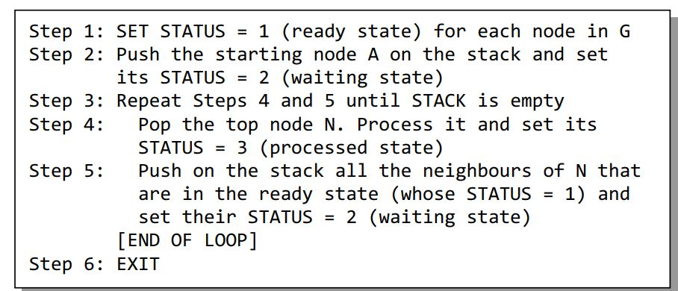
DFS

Slide 9
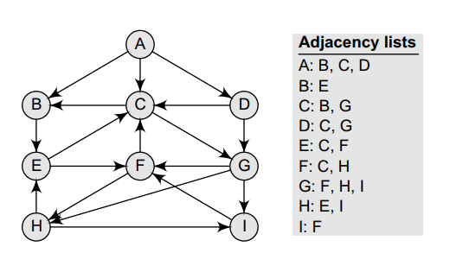
Sample directed graph

Slide 10
Problems to solve using BFS
UVA 439
UVA 352
UVA 10305

